Slide 1
Introduction to Software

Slide 2
Software
Computer software, or simply software is any set of machine-readable instructions that directs a computer's processor to perform specific operations.
Software tells the computer what to do and how to do

Slide 3
Types of Software
System Software
Application Software
Open Source Software
Proprietary Software
Malicious Software

Slide 4
System Software
A program or set of programs that is especially designed to control different operations of computer system is called system software. It controls the working of different components of the computer.
Provide a platform for running application software.
System software can be separated into two different categories, operating systems and utility software.

Slide 5
System Software - Utility Software
A utility software is a small program that provides an addition to the capabilities provided by the operating system.
It is intended to analyze, configure, monitor to maintain a computer.
Typically a utility is smaller than a standard program in size and may be included with an operating system or installed separately.

Slide 6
System Software - Utility Software
Examples:
Antivirus – Microsoft Defender, Norton 360
Backup Software – EaseUS Todo, Filefort
Compression Utility – WinZip, 7-Zip
Debuggers
Disk Checkers – Defrag, ScanDisk
Encryption Tools – LastPass, VeraCrypt
File Manager – eFileCabinet, M-Files
Memory Tester – MemTest86, DocMemory
Network Monitors – SolarWinds

Slide 7
System Software - Drivers
A device driver (commonly referred to as simply a driver) is a computer program that helps to identify,operates or controls a particular type of device that is attached to a computer.
Examples Mouse driver, keyboard driver, video card driver, sound card driver

Slide 8
Application Software
It is a set of one or more programs designed to carry out operations for a specific application.
Application software cannot run on itself but is dependent on system software to execute.
Example: Payroll systems, Inventory Control, Word Processor, Spreadsheet and Database Management System etc.

Slide 9

Open Source Software
Open Source Software (OSS) is software whose source code is available under a license that permits users to use, change, and improve the software, and to redistribute it in modified or unmodified form.
It is often developed in a public, collaborative manner.
Well-known products are Linux, Netscape, Apache, etc.

Slide 10
Proprietary Software
Software with restrictions on using, copying and modifying as enforced by the proprietor(owner).
Restrictions on use, modification and copying is achieved by either legal or technical means and sometimes both.
OR A software related to a particular company/owner and doesn’t have open source code that restricts user for modifying it under legal terms.
Example :
MS Office/Windows,
CAD,
Norton AV etc.

Slide 11

Malicious Software
Malicious software or Malware – any software used to disrupt computer operation, gather sensitive information, or gain access to private computer systems.
It contains Viruses, Worms, Trojan horses, Spyware, Adware, Ransomeware and other malicious programs

Slide 12
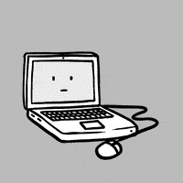
Virus
Virus is a program written to sneak into your computer and damage/alter your files/data. A virus might corrupt or delete data on your computer.
Examples of widespread computer viruses:
Morris Worm,
MyDoom,
ILOVEYOU,
Nimda

Slide 13
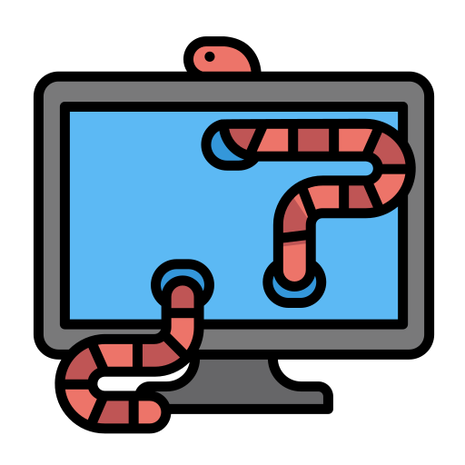
Worm
Malicious programs that make copies of themselves again and again on the local drive, network shares, etc.
Mydoom – fastest spreading email worm in 2004 sending junk emails costing $38 billion

Slide 14
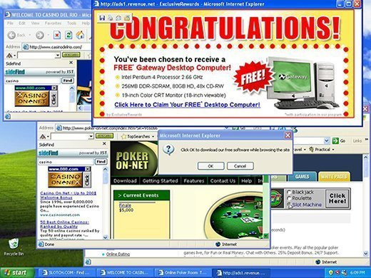
Adware
A software application in which advertising banners are displayed
Auto download to your system with some program
Fireball, DollarRevenue

Slide 15
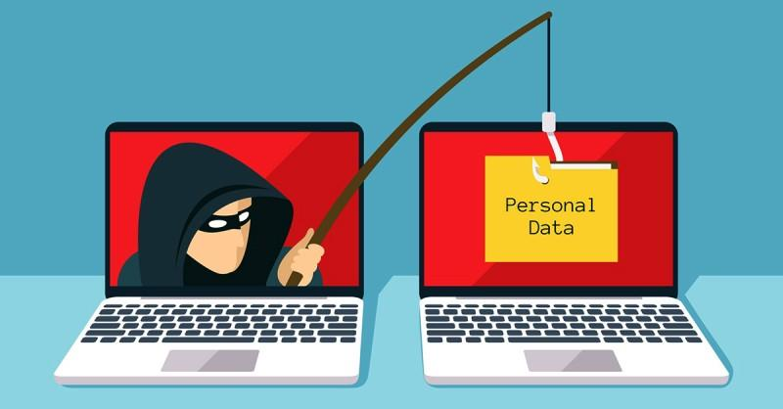
Spyware
They installed with or without your permission on your PC to collect information about users, their computer or browsing habits
Tracks each and everything that you do without your knowledge and send it to remote user
Examples - AgentTesla, Pegasus

Slide 16
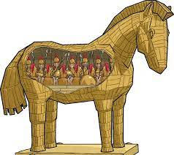
Trojan Horse
The term is derived from the ancient Greek story of the deceptive Trojan Horse that led to the fall of the city of Troy.
It is a destructive program that looks as a genuine application. Trojans also open a backdoor entry to your computer which gives malicious users/programs access to your system.
Emotet – considered as one of the most destructive and
dangerous Trojans

Slide 17
Software Programming
Software programming is the act of writing computer code that enables computer software to function. The computer technology field often has overlapping terminology that can be confusing to discern.
Ransomware:
A virus which highly encrypts files/folders and demands money/BTC to retrieve it
E.g. WannaCry, Cerber …etc.

Slide 18
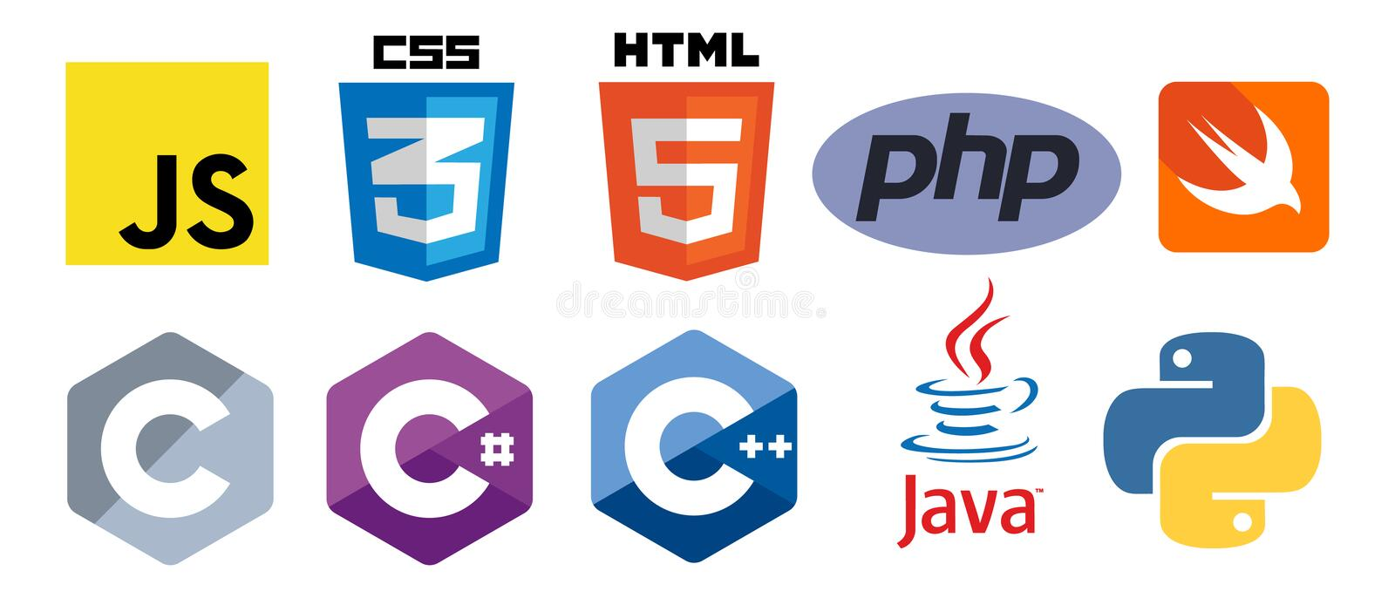
Some of the famous programming languages are:
C
C#
C++
Java
Python
HTML
CSS
PHP
JavaScript
Swift
R etc.

Slide 19
Classification of Programming Languages
Machine Language (low level language)
Assembly Language
High Level Language

Slide 20
Machine Language
Machine language is the lowest form of computer language. Programs were only written in binary based machine level language in the first generation computers. The computer understands this language only at its lowest level.
The set of instructions in a machine level language can be divided into four categories:
Arithmetic- add, subtract, multiply and divide
Controlled- load, store, jump instructions
Input/output- Read and write
Direct use- Halt, start and end
Example: Binary language (0’s and 1’s)

Slide 21
Assembly Language
Assembly language permits the use of symbols or mnemonics, which are two or three letter abbreviations, for the function to be performed by the instruction.
These are then translated by using a symbolic equivalence table.
Advantages of Assembly Languages:
They save time and reduce detail as compared to machine language.
Lesser number of errors are made(encountered), and also errors are easier to detect.
Assembly programs are easier to modify than machine language programs.

Slide 22
High Level Language
High level language is a human readable language. A high-level language is any programming language that enables development of a program in a much more user-friendly programming context and is generally independent of the computer's hardware architecture.

Slide 23
Language Translator Programs
These are programs that translate source code written in other languages into a machine language instructions code, which the computer can interpret and execute.
Assembler
Compiler
Interpreter

Slide 24
Assembler
Computer understands machine language (0’s and 1’s). Therefore, the assembly language software translates the specified operation code into its machine language equivalent before the program can be executed.
Assembly language is converted into machine language using “Assembler”.
Assemblers: An assembler translates the symbolic instruction code of programs written in assembly language into machine code .

Slide 25
Compiler
A compiler is a special program that translates a programming language’s source code into machine code or machine understandable code. Or a compiler is used for converting high level language to a low level language.
Source code → Compiler(compiler compiles code) → Machine understandable code
Compilers: A compiler is a program which produces a machine level program from the specifications of a high level language, by generating one or more than one machine instruction for each high level instruction, i.e. it translates the higher level program into machine code.

Slide 26
Interpreter
Interpreter: An interpreter translates and executes each program statement, one at a time, instead of producing a complete machine language program, like assemblers and compilers do.
With an interpreter, the source program is not assembled into an object program.
The results are computed immediately after an instruction has been translated.
This process allows very efficient use of computer and programmer time during the debugging of the application.

Slide 27
Systems / Software Development Lifecycle
Programming is a 5 step procedure.
Requirement Gathering or Specifications
Also known as data gathering stage.
Design
Design Algorithms, Pseudocode, Flowcharts etc.
Program
Software development, coding etc.
Debug / Test
Maintain
Testing, software quality assurance stage (SQA)
Documentation and software/system maintenance

